Slide 1

Testing your Python Code
Dr. Xenia Mountrouidou
Network Automation Engineer

Slide 2
Agenda
Motivation: why you should test?
Types of testing
Unit Test Examples - Mocks & Fixtures
Templates & tools
Conclusions

Slide 3

About me
Dr. X
Network Automation Engineer at Network To Code
PhD from NC State - Performance Modelling for Optical Burst Switches
Post doc at College of William and Mary - Time series modeling for energy savings in data center storage
Industry experience - IBM
Technical interests: Computer Network Security, Internet of Things, Data Analytics, and Telemetry
Hobbies: scuba diving, CTFs, reading

Slide 4
Disclaimers
Code demonstrated is Python but not perfectly “Pythonic”
Missing docstrings
Simple design patterns
Tools/design choices may vary
Not one size fits all approach

Slide 5
Motivation
Why should you test your network automation code?

Slide 6

Motivation: why test?
Increase level of confidence that product works to specs
Performance
Accessibility
UX
Quality assurance
Code review
Documentation
Test Driven Development (TDD)
Changes are not detrimental
Complete picture of product
https://toxsl.com/image/files/softwaretesting.png
Notes:
I am a convert from not testing to testing my code. The more I do it the more I like it.

Slide 7
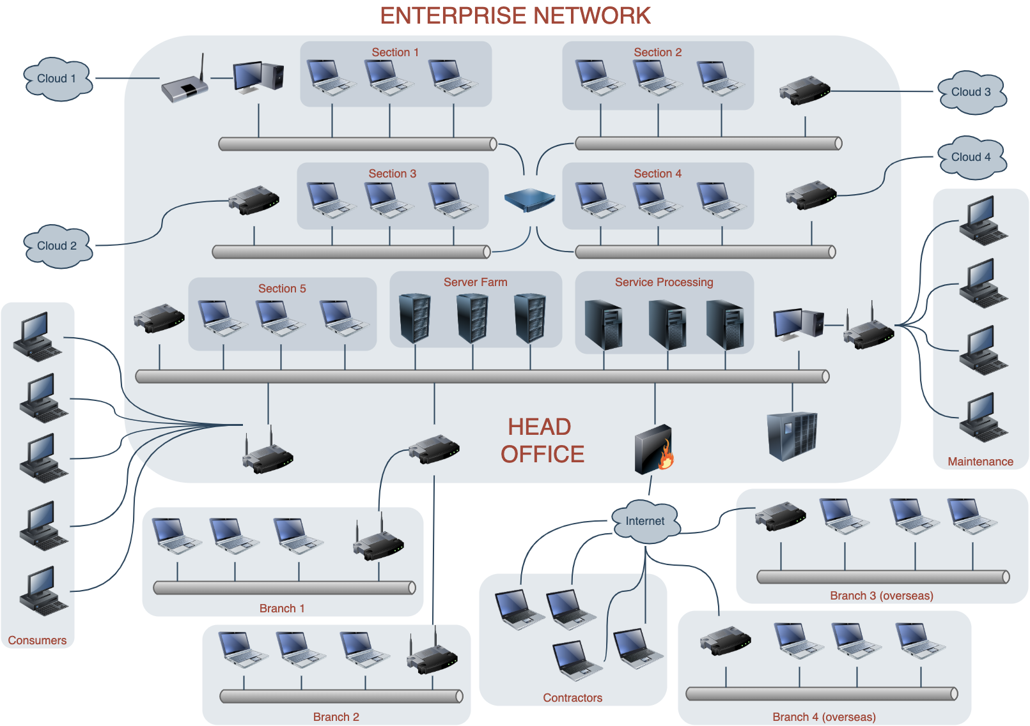
Motivation: why test for network automation?
Reliability
Reduce complexity
Manage risk
Performance
Dependencies
Volatile environment
Notes:
Physical hardware vs just testing the code on a specific OS. Know your payload, direct access to network hardware is generally restrictive. My code works but how much time do you take to fix it when it breaks?

Slide 8
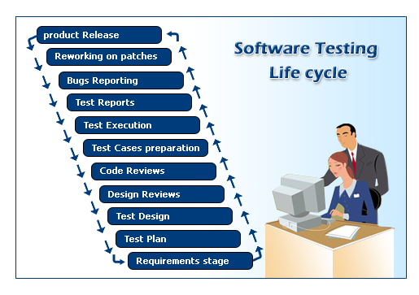
Motivation: why use different types of testing?
Completeness
Correctness
Coverage
Extensibility
Isolation
http://www.elec-intro.com/EX/05-15-18/software-testing-good.jpg
Notes:
Unit tests test functions, integration interactions, etc.

Slide 9
Types of tests
Definitions

Slide 10
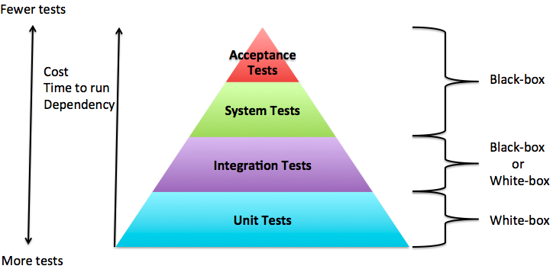
Types of tests
http://softwaretesting.natashaleite.com/wp/wp-content/uploads/2014/02/Screen-Shot-2014-02-09-at-10.43.34.png

Slide 11
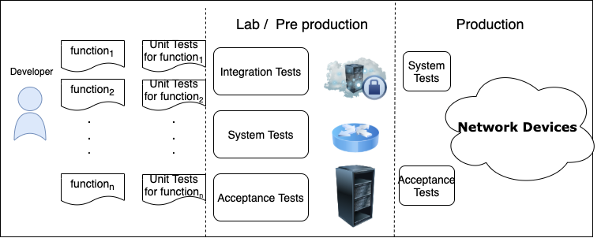
Types of tests and network automation

Slide 12

Unit testing
Self contained function testing
Lightweight
Logic checks
Part of standard Python library
Python tools
unittest
pytest
mock
nose
https://cdn.softwaretestinghelp.com/wp-content/qa/uploads/2019/12/PyTest-Logo.png

Slide 13
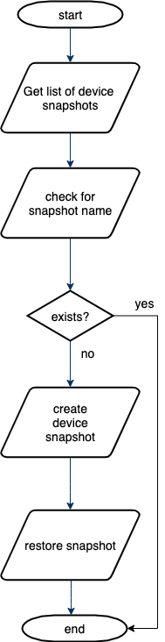
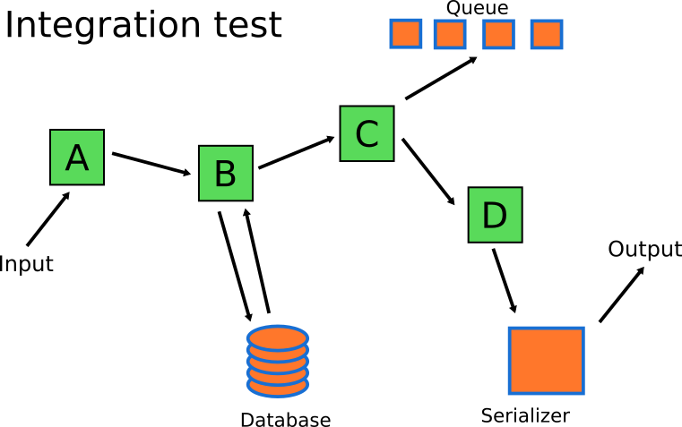
Integration testing
Combination of components tests
Functional requirements
Dependencies
Interact with system components
http://blog.codepipes.com/assets/testing-anti-patterns/correct-integration-tests.png
Notes:
Some different types of integration testing are big-bang, mixed (sandwich), risky-hardest, top-down, and bottom-up. Other Integration Patterns^{[3]} are: collaboration integration, backbone integration, layer integration, client-server integration, distributed services integration and high-frequency integration.

Slide 14
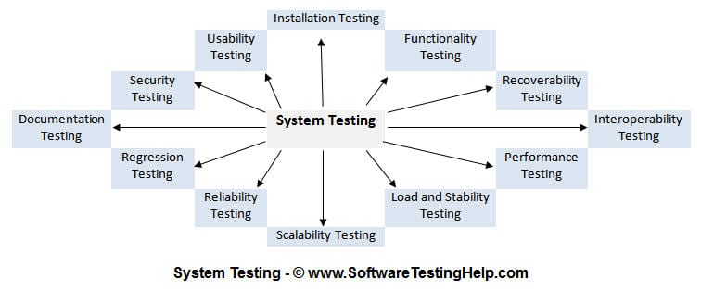
System testing
Holistic
Verify specifications
Combine all features
Types of system testing:
Usability
Load
Regression
Recovery
Migration
Functional
HW/SW

Slide 15
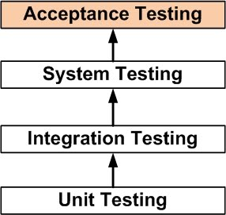
Acceptance testing
Does the product meet the customer’s needs?
Does it meet requirements?
Does it abide by business processes?
http://softwaretestingfundamentals.com/wp-content/uploads/2010/12/acceptance_testing.jpg

Slide 16
Unit Test Examples: Mocks & Fixtures
Code & demo

Slide 17
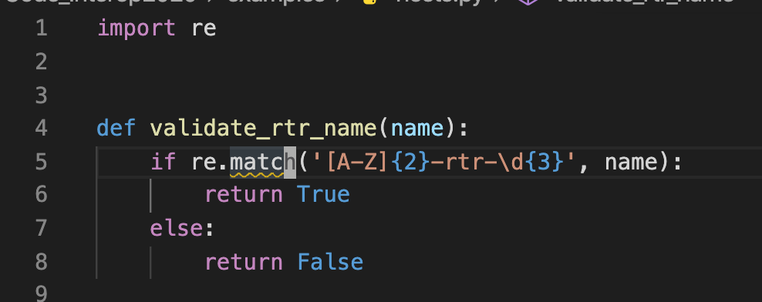
Unit Testing Python: Example function
Notes:
Emphasize that I will be demonstrating these tests using pytest. Give some technical arguments why.

Slide 18
Mocking
Substitutes and imitates a real object within a testing environment
Simulates all behavior and properties
https://docs.python.org/3/library/unittest.mock.html
Notes:
Connect back to why it is relevant to unit test and integration test. Used to run a piece of code and test it against a network device. Mock helps you avoid this.

Slide 19
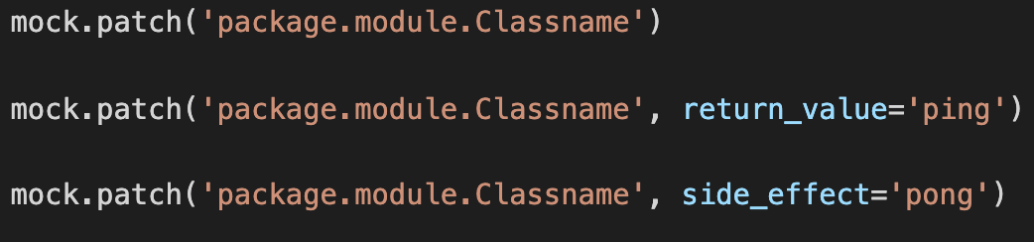
Patching
Temporarily replace target with a different object

Slide 20
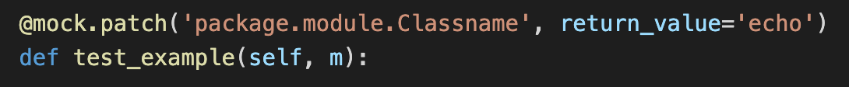
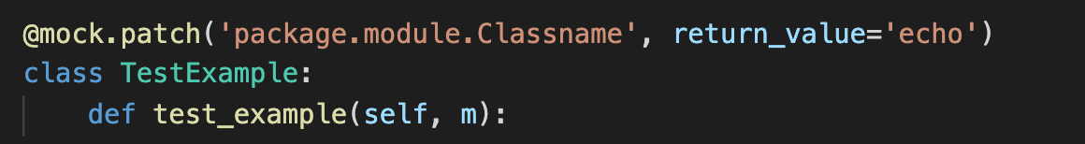
How to apply a mock
Decorator
Context manager
Inline

Slide 21
Mock examples and demo
Netmiko Connecthandler
HTTP Request

Slide 22
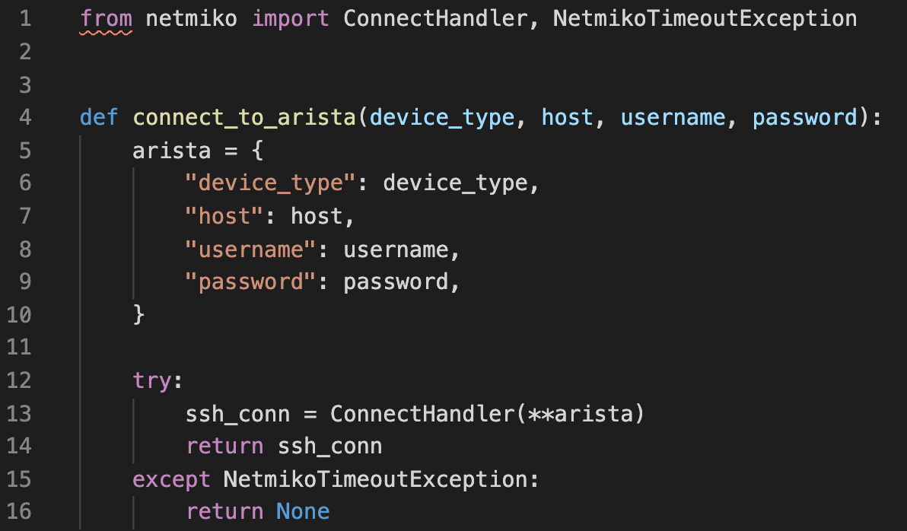
Netmiko Example Function

Slide 23
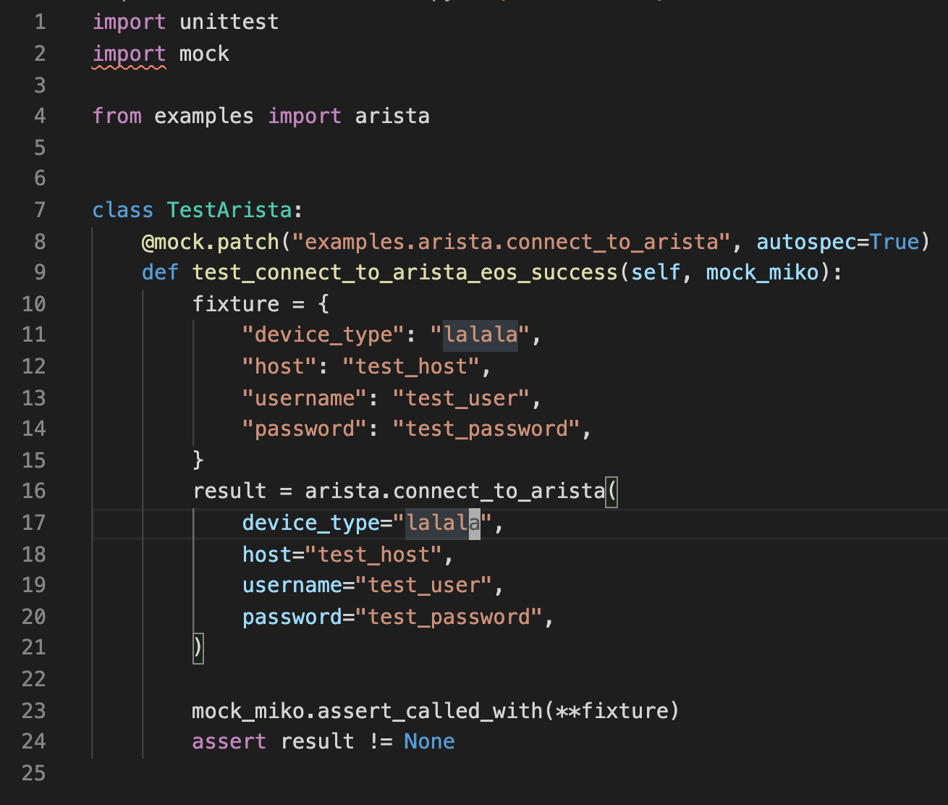
Netmiko Mock
Notes:
This will be demo and run the test

Slide 24
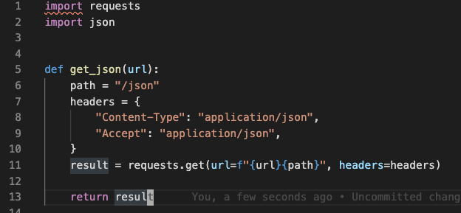
HTTP request example function

Slide 25
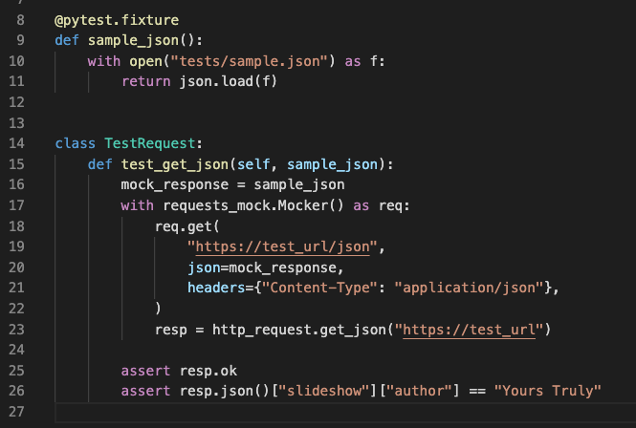
HTTP request mock

Slide 26
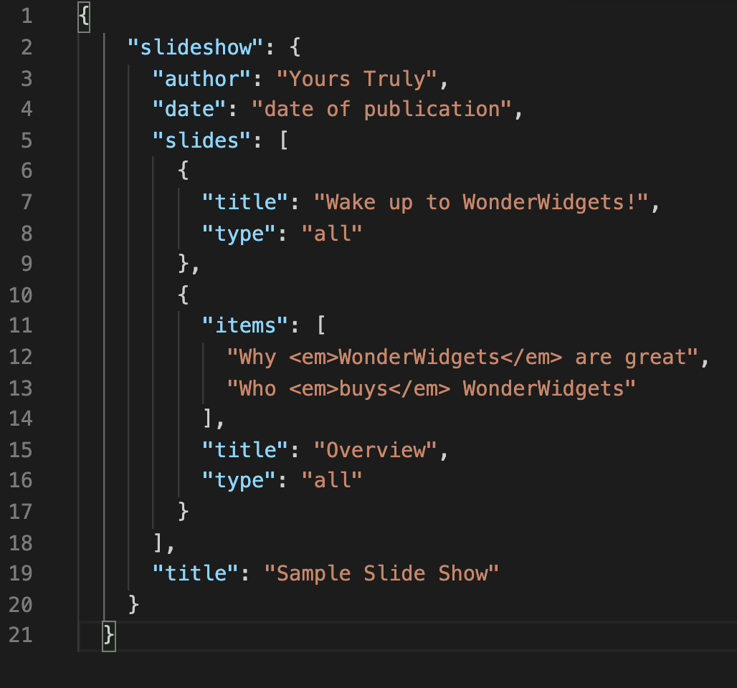
Fixtures
Functions run before test function
Feed data to your test
Can be included in separate files
conftest.py may include all fixtures
Notes:
Demo time

Slide 27
Templates & Tools
Automation for your automation

Slide 28
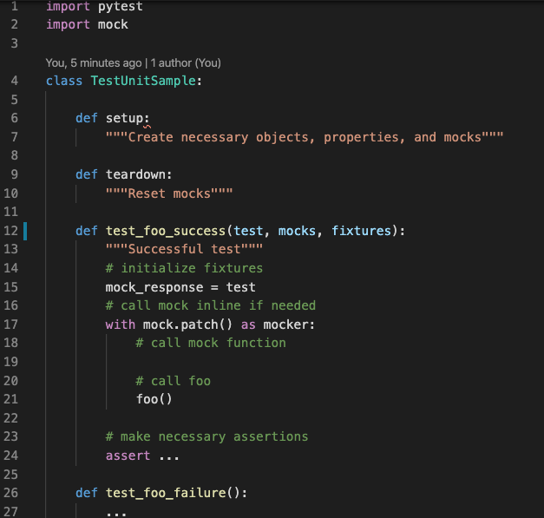
Unit Test Template
Success and failure tests
Parameters
Status
Payload
Extreme cases
Parameters, ranges etc.

Slide 29
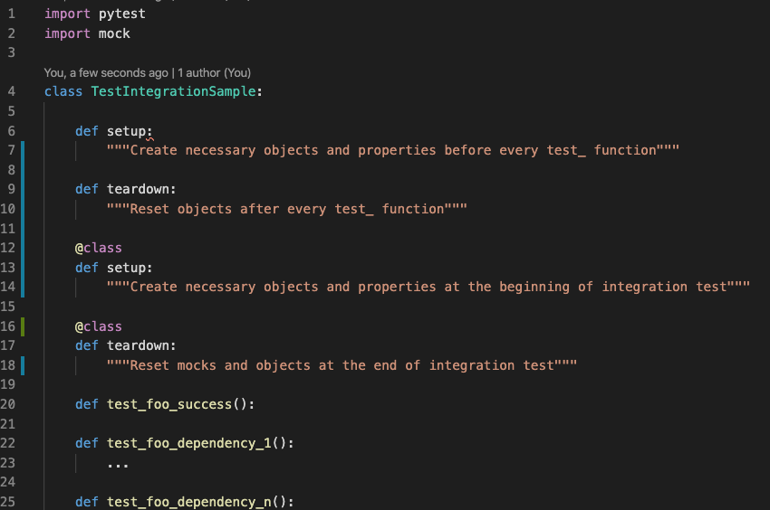
Integration Tests Template
Setup and teardown make tests self contained
Always cleanup any created objects, configs etc.
Think about function dependencies

Slide 30

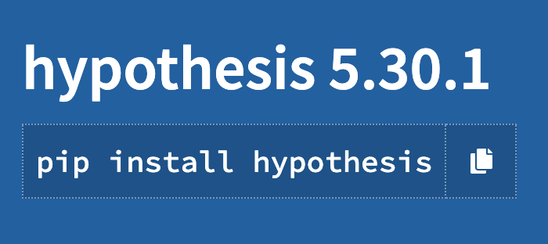
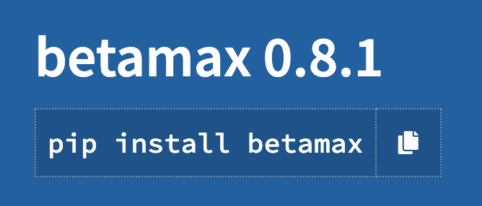
Useful Tools
Pytest
Mock
requests_mock
Hypothesis
Betamax
Coverage
Notes:
Besides pytest, mock, and magic mock

Slide 31
Conclusions
Recap and useful resources

Slide 32
Take Away
Write Unit Tests
Write Unit Tests
… Write Unit Tests
Aim for maximum coverage
Invest time on all types of tests
Think testing as a form of hacking!

Slide 33
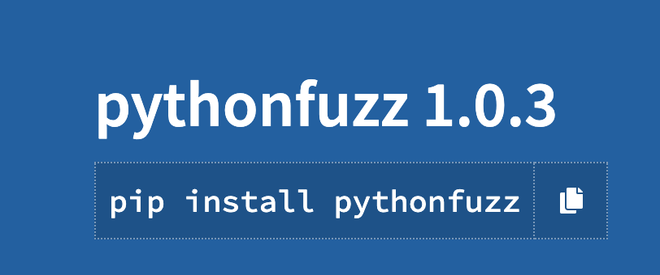
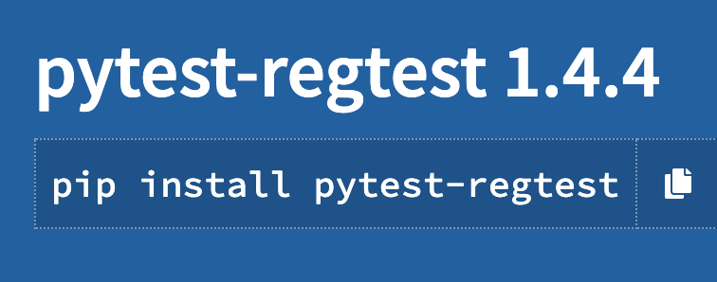
Additional Topics
Formal Verification
Fuzzing
Pytest Regression Testing
Notes:
pytest-regression

Slide 34
Thank you!
https://github.com/mundruid

Slide 35
References
Pytest docs: https://docs.pytest.org/en/latest/index.html
Software Testing Fundamentals: https://softwaretestingfundamentals.com/
Unittest Mocks: https://docs.python.org/3/library/unittest.mock.html
Request Mocks: https://requests-mock.readthedocs.io/en/latest/
Python Hypothesis: https://hypothesis.readthedocs.io/en/latest/
Pytest-regressions: https://github.com/ESSS/pytest-regressions

